Slide 1
COMP 110/L Lecture 22
Mahdi Ebrahimi Slides adapted from Dr. Kyle Dewey

Slide 2
Outline
Exceptions

Slide 3
Exceptions

Slide 4
Recall
int[] array = new int[3]; int result = array[27];
Notes:
-What happens if this code snippet is run?

Slide 5
Recall
int[] array = new int[3]; int result = array[27];
Exception in thread "main" java.lang.ArrayIndexOutOfBoundsException
Notes:
-What happens if this code snippet is run?

Slide 6
Recall
int[] array = new int[3]; int result = array[27];
Exception in thread "main" java.lang.ArrayIndexOutOfBoundsException
int result = Integer.parseInt(“hello”);
Notes:
-What happens if this code snippet is run?

Slide 7
Recall
int[] array = new int[3]; int result = array[27];
Exception in thread "main" java.lang.ArrayIndexOutOfBoundsException
int result = Integer.parseInt(“hello”);
Exception in thread "main" java.lang.NumberFormatException
Notes:
-What happens if this code snippet is run?

Slide 8
Exceptions
An exception is an unwanted or unexpected event, which occurs during the execution of a program i.e at run time, that disrupts the normal flow of the program.
Error: An Error indicates serious problem that a reasonable application should not try to catch. Exception: Exception indicates abnormal conditions that a reasonable application might try to catch.
Notes:
-For example, we can define exceptions for an array index being out of bounds (one kind of error condition),
and exceptions indicating that a number was of an unexpected format / we couldn’t parse it (another kind of error condition)

Slide 9
Exceptions
Intended to signal events which happen infrequently but cannot be ignored
“Exceptional”
Errors are common examples
Can define different kinds of exceptions for different conditions

Slide 10
Exceptions
Intended to signal events which happen infrequently but cannot be ignored
“Exceptional”
Errors are common examples
Can define different kinds of exceptions for different conditions
java.lang.ArrayIndexOutOfBoundsException java.lang.NumberFormatException
Notes:
-For example, we can define exceptions for an array index being out of bounds (one kind of error condition),
and exceptions indicating that a number was of an unexpected format / we couldn’t parse it (another kind of error condition)

Slide 11
Exceptions Handling
Is a mechanism to handle run-time errors such as ClassNotFoundException, IOException, SQLException, RemoteException, etc.
The main advantage is to maintain the normal flow of the program.

Slide 12
Exceptions Handling
Statement 1;
Statement 2;
Statement 3;
Statement 4;// Exception occurs
Statement 5;// like divided by zero
Statement 6;
The main advantage is to maintain the normal flow of the program.
Notes:
Suppose there are 6 statements in your program and there occurs an exception at statement 4.
The rest of the code will not be executed i.e. statement 5-6 will not be executed.
If we use exception handling, the rest of the program will be executed.

Slide 13
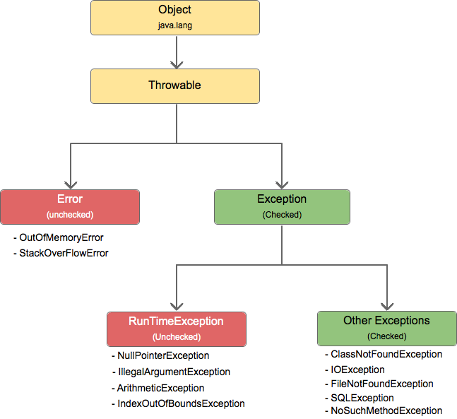
Hierarchy of Java Exception
Notes:
Check Exceptions: check at compile-time (green color)
Uncheck Exceptions: check at run-time (red color)

Slide 14
Defining Exceptions
Inherit from the Exception class.
Has a constructor that takes a String.
Notes:
-The passed String indicates a message which can encode more details (e.g., “57 is not negative”)

Slide 15
Defining Exceptions
Inherit from the Exception class.
Has a constructor that takes a String.
public class MyException extends Exception {
public MyException(String message) { super(message);
}
}
Notes:
-The passed String indicates a message which can encode more details (e.g., “57 is not negative”)

Slide 16
Example:
MyException.java

Slide 17
Throwing Exceptions
Methods must state which exceptions they throw, using the throws reserved word

Slide 18
Throwing Exceptions
Methods must state which exceptions they throw, using the throws reserved word
public static void myMethod() throws MyException {
...
}
Notes:
-Declaring that myMethod throws MyException

Slide 19
Throwing Exceptions
Methods must state which exceptions they throw, using the throws reserved word
public static void myMethod() throws MyException {
...
}
public static void myMethod()
throws MyException, OtherException {
...
}
Notes:
-Declaring that myMethod throws MyException or OtherException

Slide 20
Throwing Exceptions
Exceptions can be thrown with the throw reserved word

Slide 21
Throwing Exceptions
Exceptions can be thrown with the throw reserved word
public static void myMethod() throws MyException {
if (...) {
throw new MyException(“message”);
}
}

Slide 22
Example
MyException.java
ThrowMyException.java
Notes:
-Key point in the example: thrown exceptions can traverse method boundaries.
Main can also throw MyException even though it doesn’t explicitly use throw, since it calls something that says it throws MyException

Slide 23
Catching Exceptions
Exceptions can be caught with try...catch, stopping them from moving up

Slide 24
Catching Exceptions
Exceptions can be caught with try...catch, stopping them from moving up
try {
myMethod();
} catch (MyException e) { System.out.println(e.toString());
}
System.out.println(“GETS HERE”);

Slide 25
Example:
CatchException.java

Slide 26
5 Keywords
try: is used to specify a block where we should place exception code. The try block must be followed by either catch or finally. It means we can not use try block alone.
catch: is used to handle the exception. It must be preceded by try block which means we can not use try block alone. It can be followed by finally block later.
finally: is used to execute the important code of the program. It is executed whether an exception is handled or not.
throw: is used to throw an exception.
throws: is used to declare exceptions. It does not throw an exception. It is always used with method signature and specifies that there may occur an exception in the method.
Notes:
Suppose there are 6 statements in your program and there occurs an exception at statement 4.
The rest of the code will not be executed i.e. statement 5-6 will not be executed.
If we use exception handling, the rest of the program will be executed.

